Slide 1
Map Project for Pälkjärven Pitäjäseura ry.
Goal of this project is to develop and implement a database, to implement a web application and integrate the database and application to www.palkjarvi.fi.
The whole project is about people who used to live in Karelia, Pälkjärvi area in 1939. In the database, there will be information about public buildings, houses, people who lived there and pictures/videos of how the buildings looked like back in 1939 and how the ruins look like now.
This project will make information easily available for anyone interested about the subject, but the main target users are people who used to live there before the war and their descendants.

Slide 2
Functionality for end users
Search data
View location coordinates on a map
Click on coordinates to view information
View pictures/videos from a location
Only administrator has the right to edit data

Slide 3
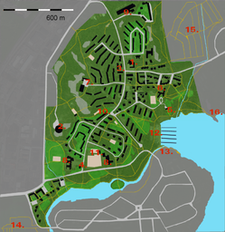
Title
Search
Link
Search results

Slide 4

